Slide 1

Combating Climate Change
With Trapping Carbon
Maddie leeflang

Slide 2
Overview
Slide 3: History of Trapping Carbon
Slide 5: How does Concrete Trap Carbon?
Slide 8: Plan and Implementation
Slide 9: Upsides to the Advancement
Slide 10: Downsides

Slide 3

History of Trapping Carbon
Idea was first developed by the UCLA CarbonBuilt team, led by Gaurav Sant, a professor of civil and environmental engineering at the UCLA Samueli School of Engineering.
Sant joined the UCLA faculty in 2010. He and a group of staff scientists, postdoctoral scholars and doctoral students began the research that led to the award in 2014.
Notes:
The winning technology is a first-of-its-kind, eco-friendly approach for taking carbon dioxide emissions directly from power plants and other industrial facilities — emissions that would otherwise go into the atmosphere — and infusing them into a new type of concrete invented by the team. As it hardens and gains strength, the specially formulated concrete permanently absorbs and traps the greenhouse gas.
Through extensive research at UCLA and testing at the Integrated Test Center, a facility outside of Gillette, Wyoming, the researchers demonstrated that their process reduced the carbon footprint of concrete by more than 50% while producing concrete that was just as strong and durable as the traditional material.

Slide 4
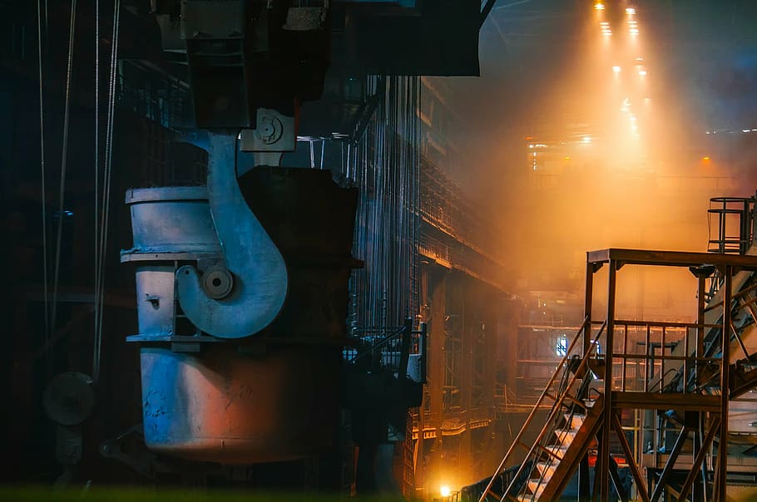
When did the first company start manufacturing?
Carbicrete, which was founded in 2016, licenses its technology to concrete manufacturers who can integrate it into their existing production processes for concrete masonry units (CMUs) and precast panels.
In collaboration with Quebec manufacturer Patio Drummond, the company is building up its production capabilities to 25,000 CMUs per day while the first building using material is set to be built in Canada at the start of 2017.
Notes:
n addition to absorbing carbon dioxide into the concrete, CarbonBuilt’s Reversa process reduces the amount of ordinary portland cement needed to produce concrete by between 60% and 90%. The process also occurs at ordinary temperatures and pressures. As a result, CarbonBuilt concrete has a much smaller carbon footprint than conventional concrete. That could go a long way toward reducing the world’s greenhouse gas output, since the production of traditional cement used in concrete is the cause of nearly 9% of the world’s carbon dioxide emissions.

Slide 5


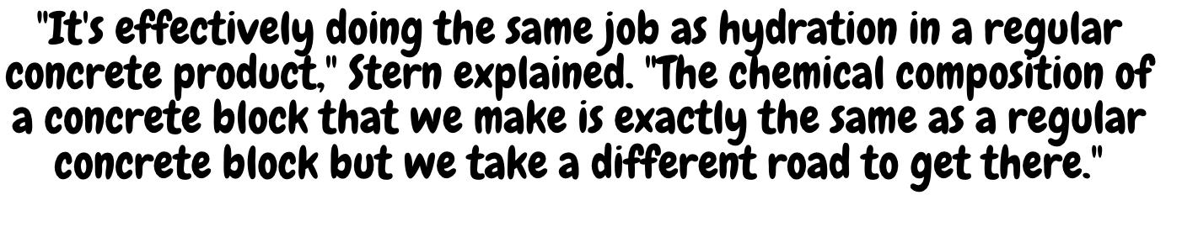

In traditional concrete production, cement is cured with water, causing the calcium to react with the CO2 in the surrounding air and turning it back into strengthened calcium carbonate.
But in Carbicrete's system, the calcium oxide is instead injected with CO2 captured from industrial sites. This curing process creates calcium carbonate, which helps to fortify the concrete. Kind of like a synthetic limestone.
Notes:
https://www.dezeen.com/2021/06/15/carbon-capturing-concrete-carbicrete/
The company is one of many that is racing to find low-carbon or carbon-free alternatives to traditional concrete but is one of the only ones claiming to have achieved negative carbon.
Instead of cement, Carbicrete's system combines waste slag from the steel industry plus carbon captured from industrial plants that would otherwise have gone into the atmosphere in a process known as mineral carbonation.
"We're taking it from there and then injecting it into concrete and getting rid of it forever," Stern said.
More carbon is captured during the production process than is emitted during the manufacture of the concrete, making the resulting concrete carbon-negative according to Stern.

Slide 6
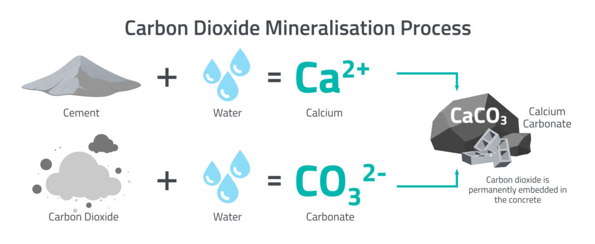
Here is an easier way to visualize

Slide 7
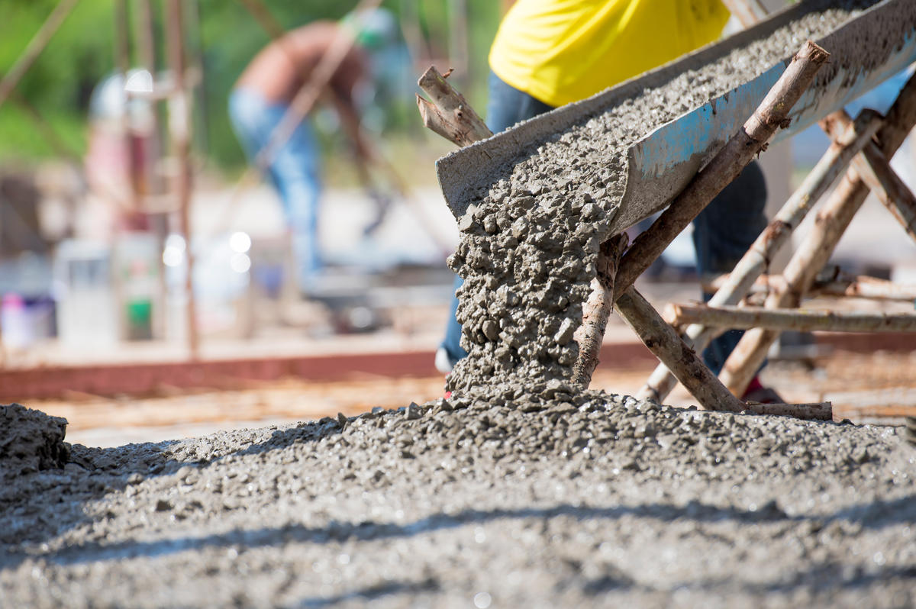

Slide 8
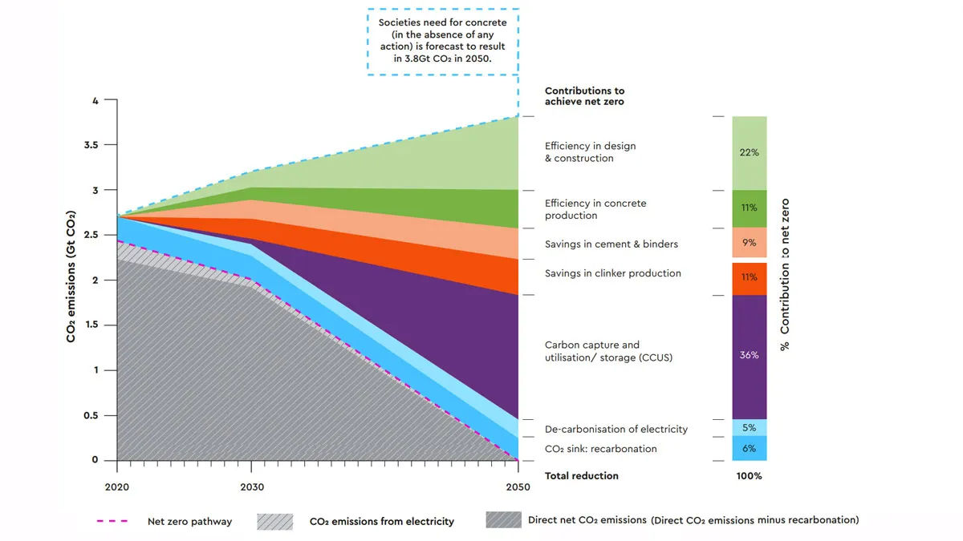
Plan and Implementation
PLANS IN NORWAY
HeidelbergCement Norcem plans to capture 400,000 tons of CO2 annually from the cement factory in Brevik, Norway, about half of the factory’s overall emissions.
Once completed in the summer of 2024, the carbon will be compressed and liquefied using technologies from Aker Carbon Capture and MAN Energy Solutions. From there, the liquefied CO2 will be transported by ship to an underground storage location, MAN announced.

Slide 9
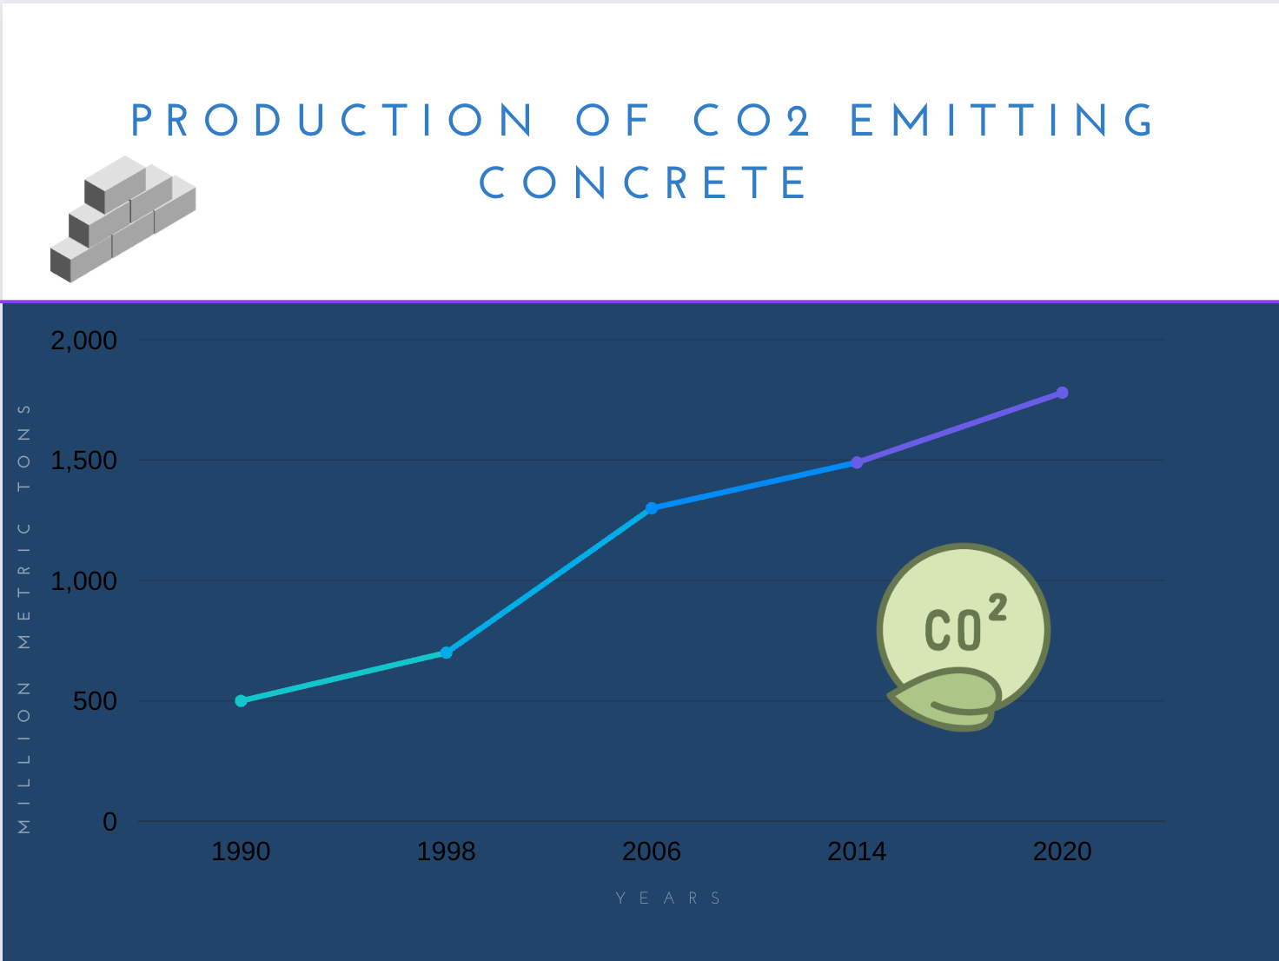

Upsides to the Advancement

Slide 10

Downsides
Very expensive
100$ per ton
But new plans emerge to make it cost-effective
Notes:
https://www.google.com/search?q=how+expensive+is+carbon+trapping+conrete&rlz=1C5GCEA_enUS1043US1044&oq=how+expensive+is+carbon+trapping+conrete&aqs=chrome..69i57j33i10i160.14927j0j4&sourceid=chrome&ie=UTF-8&safe=active&ssui=on
https://www.iea.org/commentaries/is-carbon-capture-too-expensive

Slide 11

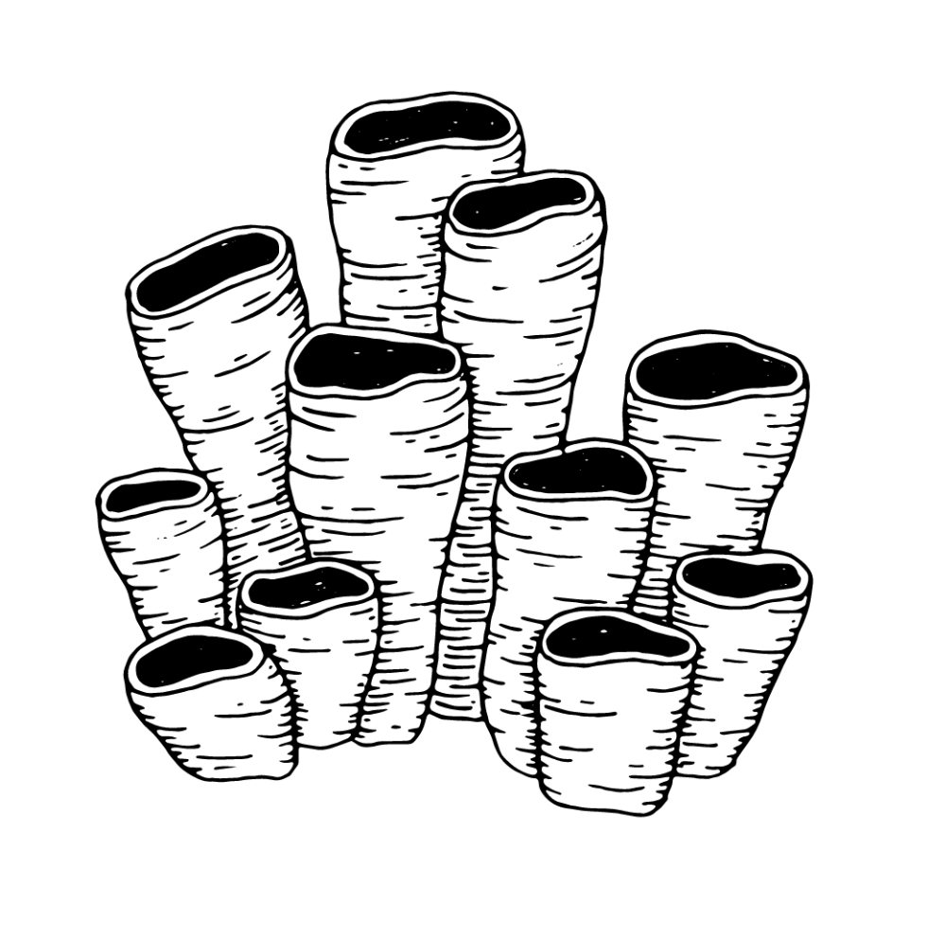
Alternate ways of trapping carbon (with rock)
Most ways of capturing and storing carbon are temporary, even if long-term. In Project Vesta, researchers are seeking ways to grind down a naturally occurring mineral called olivine into a filter to remove CO₂ from rainwater and break it down into compounds for marine organisms to digest into shells and skeletons, which would eventually settle onto the ocean floor and form layers of rock. This process would be inexpensive and powered by the ocean itself, and it potentially could store trillions of tons of CO₂ for millions of years.

Slide 12
sources
https://www.compressortech2.com/news/large-scale-co2-capture-project-to-halve-emissions/8017116.article#:~:text=HeidelbergCement%20Norcem%2C%20a%20Norwegian%20cement,technology%20from%20Man%20Energy%20Solutions.
www.sap.com
www.dezeen.com
Newsroom.ucla.edu

